Slide 1
HOTEL RESERVATION DEMAND ANALYSIS

Slide 2
OUR TEAM
HANA ALAAELDIN
MOHAMED ABABSA
REEM SAEED
hanasaleh488@gmail.com
+201004539507
m.ababsa@esi-sba.dz
+213 799737392
*MAHMOUD SHAWKY
reemsaeed1313@gmail.com
+971 55 553 9036
Mahmoudshawky12_@hotmail.com
+20 1149914669

Slide 3
TABLE OF CONTENTS
01
02
INTRODUCTION
UNDERSTANDING THE DATA
03
04
PREPROCESSING STEPS
EXPLORATORY DATA ANALYSIS (EDA)
05
06
KEY INSIGHTS AND FINDINGS
CONCLUSION AND RECOMMENDATIONS

Slide 4
01
INTRODUCTION
Overview of the project and objectives.

Slide 5
INTRODUCTION
Hotel reservation demand analysis helps understand booking trends, customer behavior, and key factors influencing cancellations and successful reservations. By analyzing booking patterns, we can provide valuable insights into how hotels can optimize their pricing strategies, improve occupancy rates, and enhance guest satisfaction.

Slide 6
OVERVIEW OF THE PROJECT AND OBJECTIVES
OVERVIEW
This project focuses on analyzing hotel reservation data to uncover trends and patterns that impact booking behavior, pricing, and customer segmentation.
OBJECTIVES
The goal is to extract actionable insights that can help optimize room pricing, reduce cancellations, and improve customer satisfaction.

Slide 7
IMPORTANCE OF ANALYZING HOTEL RESERVATION DATA
Identifies factors influencing cancellations, allowing hotels to implement better policies.
Supports strategic decision-making to maximize occupancy and profitability.
Helps predict demand trends for better inventory and revenue management.
Provides insights into customer behavior, enabling personalized marketing and services.

Slide 8
02
UNDERSTANDING THE DATA
Brief explanation of the dataset.

Slide 9
COLUMN DESCRIPTIONS
Booking_ID
Number of Adults
Number of Children
Number of Weekend Nights
Number of Week Nights
Type of Meal
Unique identifier for each booking.
Number of adults in the booking.
Number of children in the booking.
Number of weekend nights (Saturday & Sunday) booked.
Number of weeknights (Monday–Friday) booked.
Type of meal plan selected by the customer.

Slide 10
COLUMN DESCRIPTIONS
Car Parking Space
Room Type
Lead Time
Market Segment Type
Repeated Guest
P-C (Previous Cancellations)
Indicates whether a parking space was requested (0 = No, 1 = Yes).
Category of room reserved.
Number of days between the booking date and arrival date.
Source or type of booking (e.g., Online, Corporate, Direct, etc.).
Whether the customer is a returning guest (0 = No, 1 = Yes).
Number of past cancellations by the customer.

Slide 11
COLUMN DESCRIPTIONS
P-not-C
Average Price
Special Requests
Date of Reservation
Booking Status
Number of past bookings that were not canceled.
Average price per night for the booking in euros.
Total number of special requests made by the customer.
Date when the reservation was made.
Indicates whether the booking was canceled or confirmed.

Slide 12
DATA SOURCE AND ITS SIGNIFICANCE IN THE ANALYSIS
It is valuable for understanding how customers book rooms, what factors influence cancellations, and which segments contribute the most to revenue.
The dataset originates from hotel booking systems, capturing real-world reservation data.
This analysis is crucial for hotels to optimize pricing strategies, improve guest experience, and reduce revenue losses due to cancellations.

Slide 13
03
PREPROCESSING STEPS

Slide 14
PREPROCESSING STEPS
STEP 1 - DATA CLEANING
STEP 2 - FEATURE ENGINEERING
Checked missing values, standardized column names, and converted dates.
Extracted date components, created new features, and categorized guests.
STEP 3 - ENCODING & TRANSFORMATION
STEP 4 - FINAL VALIDATION
One-Hot Encoded categories, removed irrelevant columns.
Verified data consistency and ensured readiness for analysis.

Slide 15
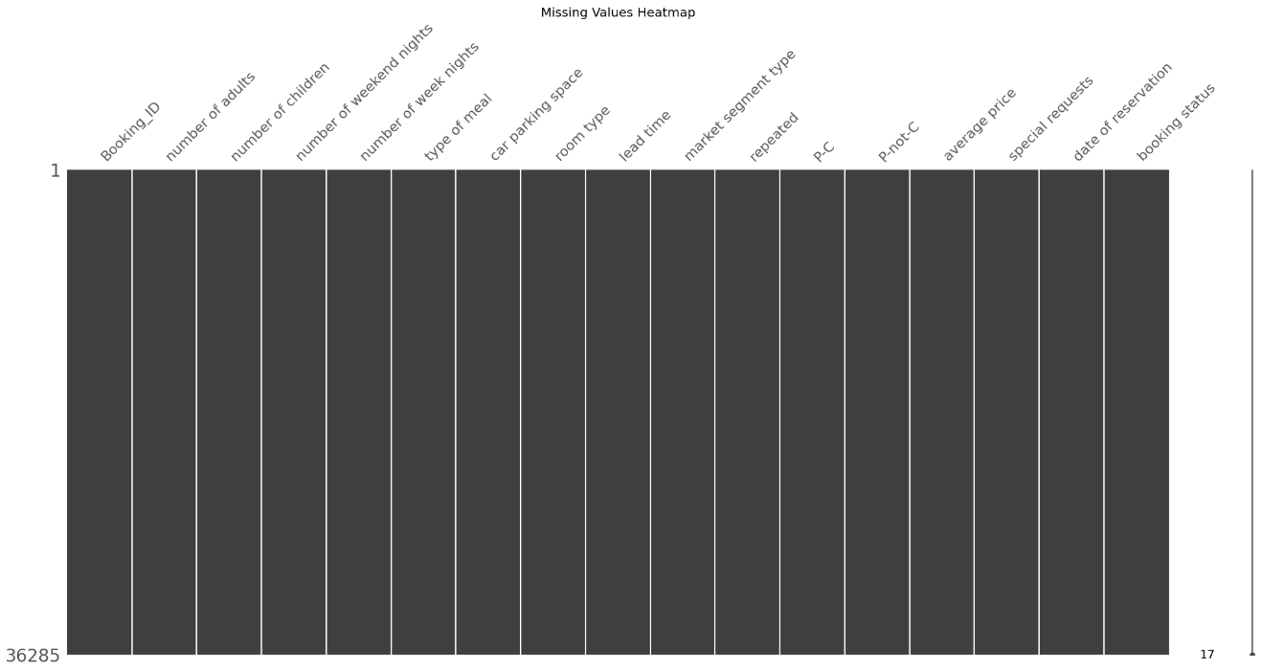
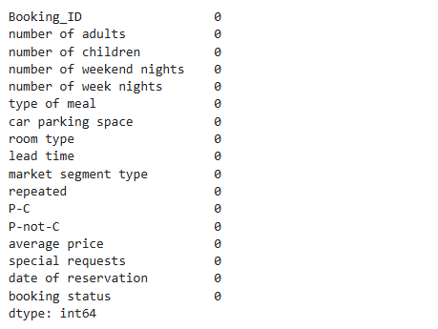
STEP 1 - DATA CLEANING
Checked for missing values using visualizations (MissingNo) and confirmed that there are no missing values in the dataset.

Slide 16
STEP 1 - DATA CLEANING
Converted date columns into datetime format for better analysis.
Standardized column names for consistency.

Slide 17
STEP 2 - FEATURE ENGINEERING
Created new features to enhance the dataset:
Total nights stayed (total_nights) – Sum of weekday and weekend nights.
Total guests (total_guests) – Combined count of adults and children.
Guest category (guest_category) – Categorized guests into Solo, Couple, Small Group, or Large Group.
Reservation weekday (reservation_weekday) – Extracted the day of the week from reservation date.
Weekend indicator (is_weekend) – Flagged reservations made on weekends.
Cancellation flag (canceled) – Binary flag (1 = Canceled, 0 = Not Canceled).

Slide 18
STEP 3 - ENCODING & TRANSFORMATION
Scaled numerical values where necessary.
Dropped unique identifiers (Booking_ID) since they do not contribute to meaningful insights.
Applied One-Hot Encoding for categorical features.

Slide 19
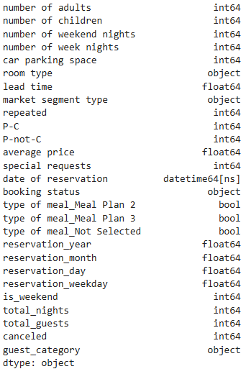
STEP 4 - FINAL VALIDATION
Ensured all variables are properly formatted.
We check that all categorical and numerical columns are in the correct format

Slide 20
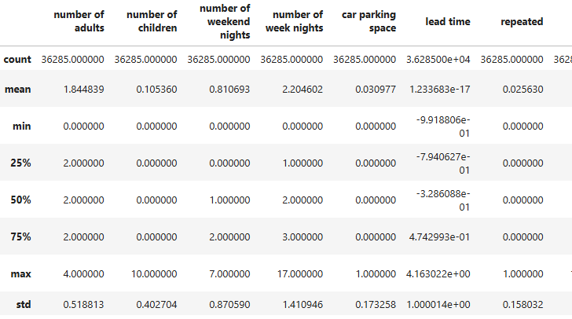
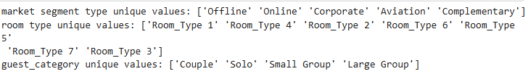
STEP 4 - FINAL VALIDATION
Conducting Initial Exploratory Analysis
Before EDA, we check data distribution and outliers

Slide 21
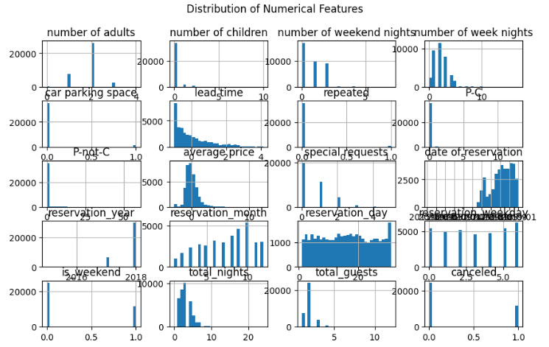
STEP 4 - FINAL VALIDATION
Conducting Initial Exploratory Analysis
To visualize distributions, we can plot histograms

Slide 22
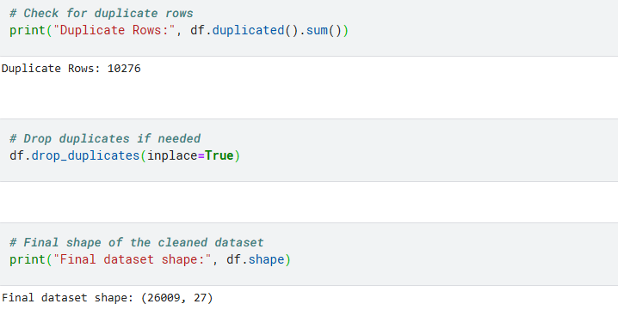
STEP 4 - FINAL VALIDATION
Verifying Dataset Integrity
To ensure there are no duplicates or inconsistencies

Slide 23
04
EXPLORATORY DATA ANALYSIS (EDA)

Slide 24
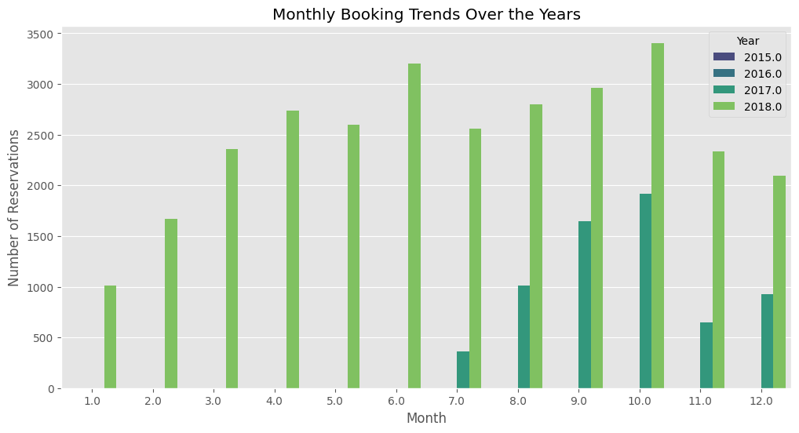
BOOKING TRENDS OVER TIME
Monthly reservations over the years to detect seasonal trends.
🔍 Key Observations
Booking patterns show seasonal trends, with certain months having significantly higher reservations.
There are yearly variations, indicating possible impacts of external factors such as economic conditions or travel restrictions.
Understanding peak booking months can help optimize marketing strategies and pricing policies.

Slide 25
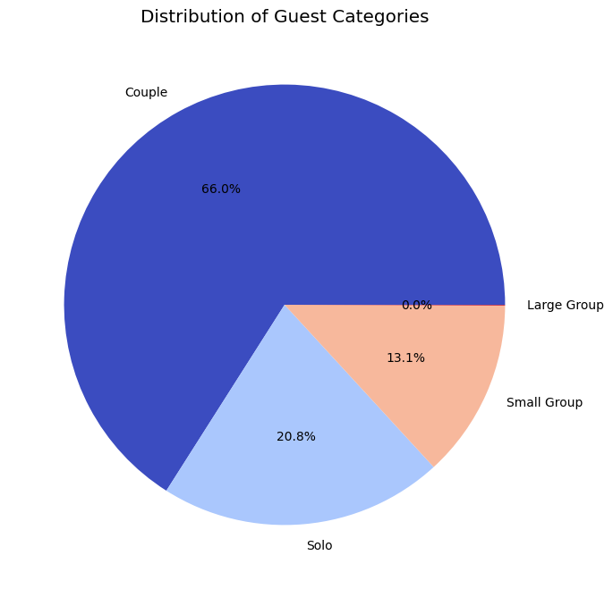
GUEST ANALYSIS
Guest category insights (Solo, Couple, Small Group, Large Group).
🔍 Key Observations
The majority of bookings are from solo travelers and couples, while larger groups make up a smaller proportion.
Hotels can use this data to tailor room configurations and promotions to suit their primary customer base.
The distribution indicates a potential opportunity to attract group bookings through special offers.

Slide 26
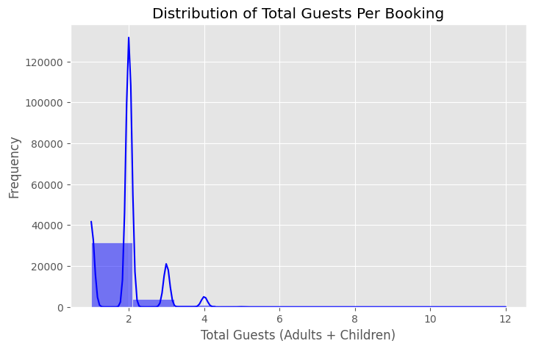
GUEST ANALYSIS
Distribution of total guests per booking.
🔍 Key Observations
Most reservations are for solo travelers or couples, while larger groups are less common.
There is a noticeable drop in bookings for groups larger than 4 guests.
Understanding this pattern can help hotels optimize room configurations and target marketing campaigns effectively.

Slide 27
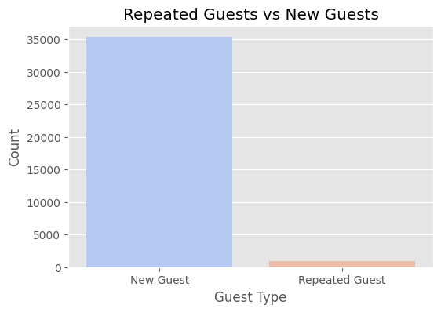
GUEST ANALYSIS
Repeated vs. new customers
🔍 Key Observations
The majority of guests are new customers, while repeated guests form a smaller segment.
Increasing repeated guest numbers through loyalty programs or personalized offers could improve long-term revenue.
Understanding guest retention rates can help enhance customer relationship strategies.

Slide 28
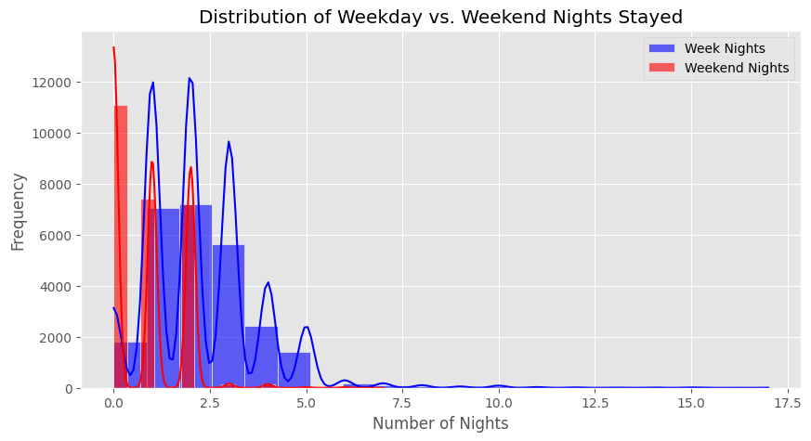
STAY DURATION
Weekday vs. weekend nights booking patterns.
🔍 Key Observations
Most bookings are for short stays (1-5 nights), with longer stays being rare.
Weekday stays are more frequent, likely due to business travelers.
Weekend stays peak at 1-2 nights, suggesting short leisure trips.
Hotels can offer discounts for extended stays to attract long-term guests.
Insights help in pricing and inventory management.

Slide 29
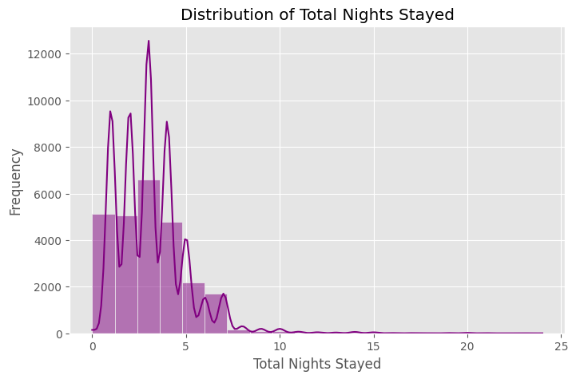
STAY DURATION
Average Length of Stay Distribution
🔍 Key Observations
Most bookings are for short stays (1-5 nights), with longer stays being less common.
This distribution suggests that hotels may benefit from targeting extended stay guests with discounts.
Analyzing length-of-stay trends helps in inventory and pricing optimization.

Slide 30
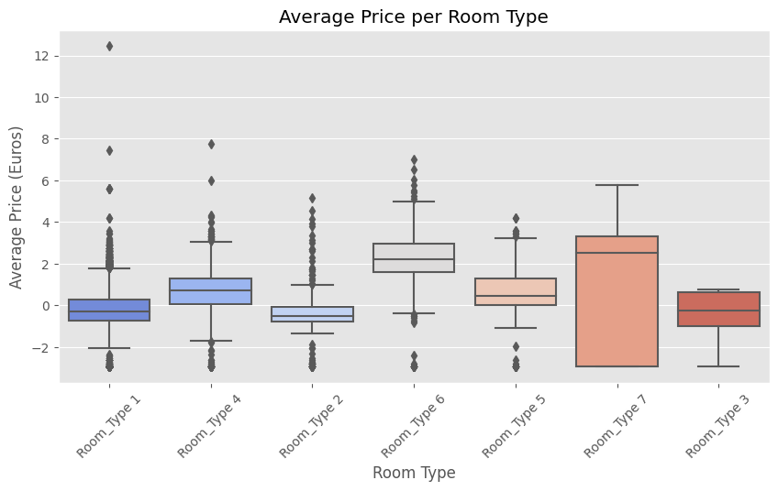
PRICING TRENDS
Average price per room type
🔍 Key Observations
The average price varies significantly across different room types.
Some room types have wider price distributions, suggesting dynamic pricing strategies based on demand.
Luxury room types show higher median prices with occasional outliers, indicating special high-rate bookings.

Slide 31
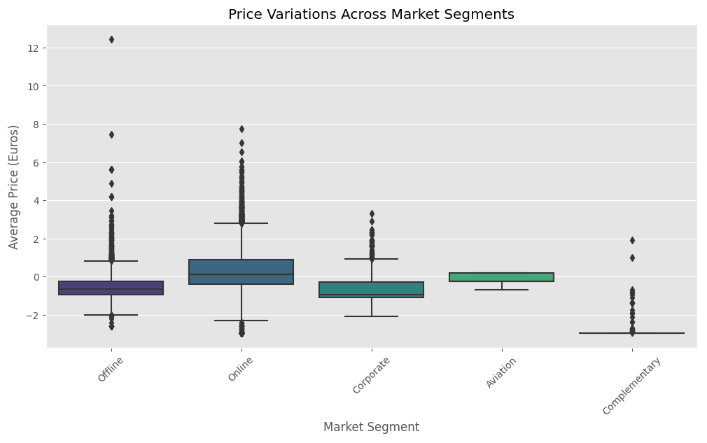
PRICING TRENDS
Price variations across different market segments
🔍 Key Observations
Online bookings have higher price variability, indicating dynamic pricing.
Corporate and offline bookings show lower, stable prices, likely due to negotiated rates.
Aviation bookings have a narrower price range, suggesting fixed contracts
Complementary stays are near zero, reflecting special offers or loyalty programs.

Slide 32
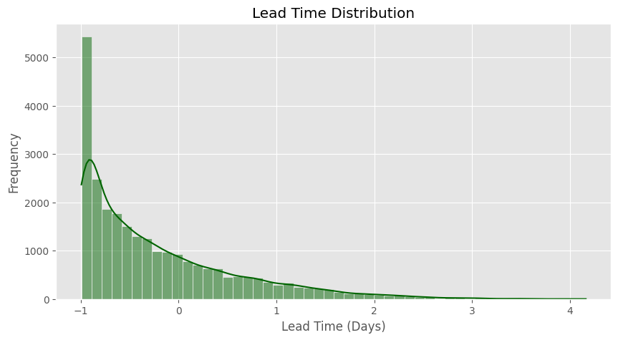
CANCELLATION ANALYSIS
Factors affecting booking cancellations (lead time)
🔍 Key Observations
Most bookings have short lead times, indicating last-minute reservations are common.
Some bookings occur far in advance, suggesting demand from well-planned travelers.
Understanding lead times helps hotels adjust cancellation policies and manage inventory more effectively.

Slide 33
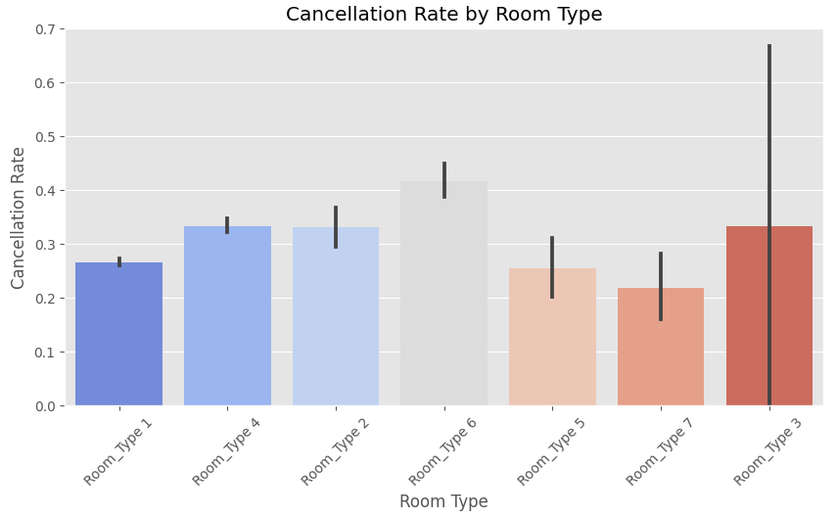
CANCELLATION ANALYSIS
Factors affecting booking cancellations (room type)
🔍 Key Observations
Room Types 6 and 3 have the highest cancellation rates, indicating higher booking uncertainty.
Room Types 5 and 7 show the lowest cancellation rates, meaning guests are more likely to complete their stay.
Room Type 3 has a large variability in cancellations, suggesting inconsistent guest decisions.
Hotels can adjust pricing and cancellation policies to minimize revenue loss on high-risk room types.

Slide 34
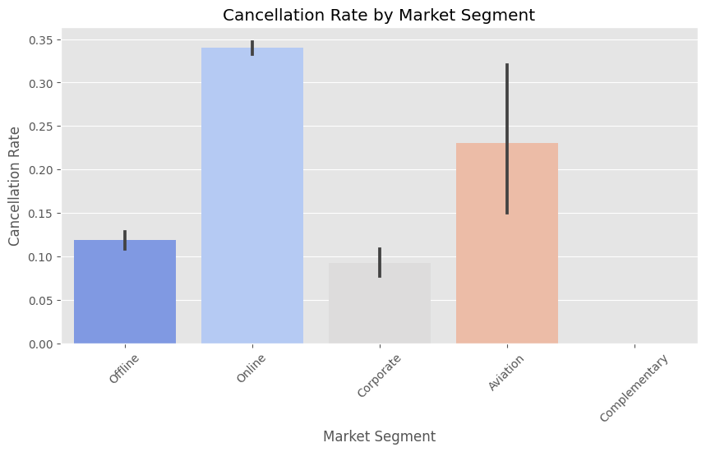
CANCELLATION ANALYSIS
Cancellation rate by market segment
🔍 Key Observations
Certain market segments show higher cancellation rates, indicating potential risks for revenue loss.
Online and travel agency bookings appear to have a higher rate of cancellations.
This insight can help the hotel adjust cancellation policies or offer non-refundable rates to high-risk segments.

Slide 35
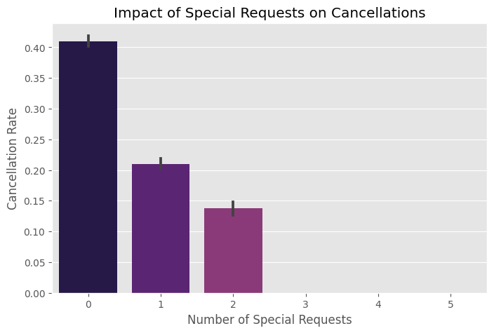
CANCELLATION ANALYSIS
Special requests impact on cancellations
🔍 Key Observations
Guests with higher numbers of special requests tend to cancel less often.
This may indicate more engaged travelers who are certain about their stay.
Encouraging customers to make specific requests could help reduce cancellations.

Slide 36
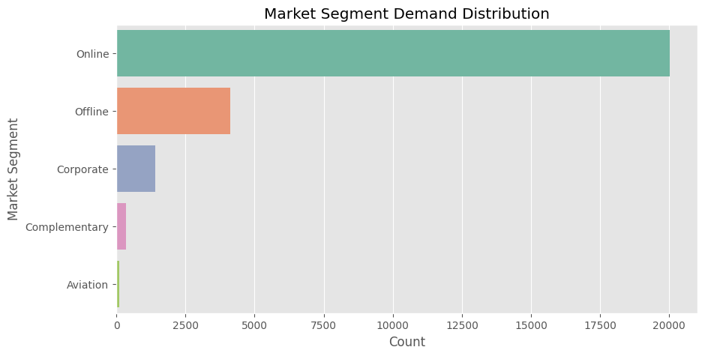
MARKET SEGMENTATION
Market segment demand distribution
🔍 Key Observations
Certain market segments dominate bookings, showing reliance on specific customer types.
Segments like online travel agencies or corporate clients could have different behaviors and price sensitivities.
Identifying high-demand segments can help hotels tailor promotions and optimize pricing strategies.

Slide 37
05
KEY INSIGHTS AND FINDINGS

Slide 38
KEY INSIGHTS FROM EDA
BOOKING TRENDS
Monthly reservations show seasonal peaks, with certain months consistently experiencing higher booking volumes, making them ideal for targeted promotions. This pattern highlights the importance of seasonal demand forecasting and strategic pricing adjustments.
GUEST BEHAVIOR
The majority of bookings are from solo travelers and couples, indicating a preference for smaller group stays. Additionally, repeated guests form a small proportion, suggesting an opportunity to enhance loyalty programs to encourage return bookings.
STAY DURATION
Most guests tend to stay for short durations (1-5 nights), and the distribution of weekday vs. weekend stays is balanced, indicating a mix of business and leisure travelers. Understanding these trends can help optimize room availability and pricing models.
PRICING TRENDS
Different room types have distinct pricing distributions, reinforcing the need for segmentation-based pricing strategies. Some room categories show wider price ranges, indicating dynamic pricing practices that adjust rates based on demand and availability.
CANCELLATION INSIGHTS
Certain segments, particularly Online Travel Agencies (OTAs), exhibit higher cancellation rates, emphasizing the need for stricter cancellation policies or incentives for direct bookings. Additionally, longer lead times correlate with increased cancellations, indicating a higher risk of overbooking for early reservations.

Slide 39
06
CONCLUSION AND RECOMMENDATION

Slide 40
BUSINESS TAKEAWAYS FROM THE ANALYSIS
The findings highlight seasonal booking trends, guest behavior patterns, and market segment variations that directly impact hotel revenue. Short stays are the most common, weekday and weekend bookings are balanced, and certain room types and customer segments show higher cancellation rates. Understanding these trends allows hotels to optimize inventory management, pricing strategies, and marketing efforts.

Slide 41
SUGGESTIONS FOR IMPROVING HOTEL RESERVATION STRATEGIES
Dynamic Pricing: Implement demand-based pricing for peak seasons and adjust rates based on room type preferences.
Cancellation Policies: Introduce stricter cancellation rules or non-refundable booking incentives for high-risk segments like OTAs.
Loyalty Programs: Enhance rewards and personalized offers to increase the proportion of repeated guests and reduce cancellations.
Targeted Promotions: Use insights on seasonality and guest behavior to offer discounts for extended stays and attract group bookings.
Improve Direct Bookings: Encourage customers to book directly through discounts and exclusive perks, reducing dependency on high-cancellation channels.

Slide 42
THANK YOU!

